Slide 1


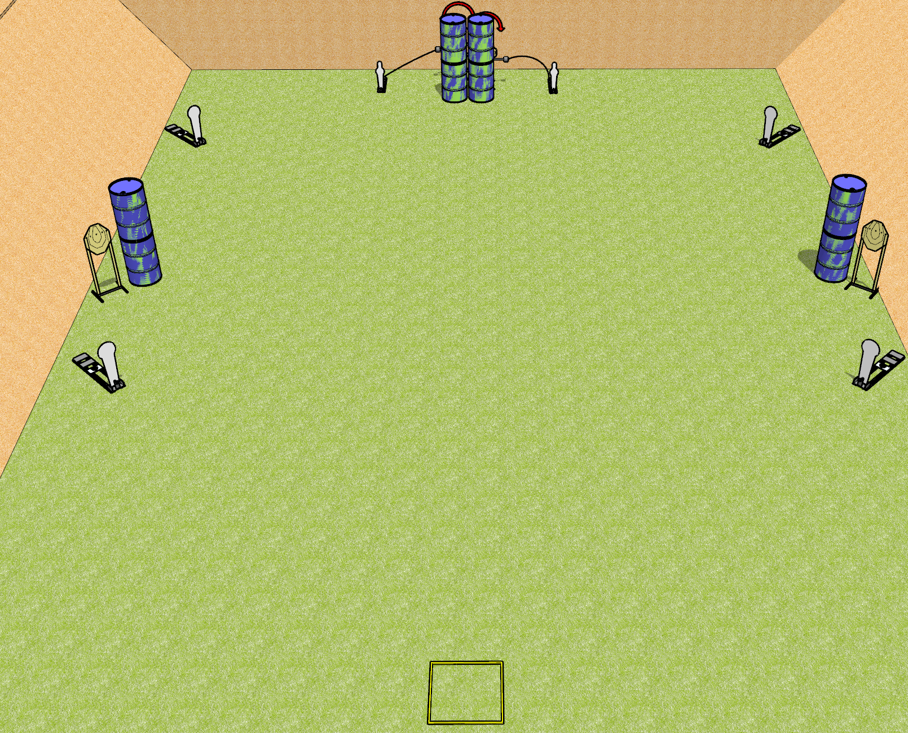
 | Dothan Gun Club – USPSA Match Quickness Course Designer : Drew Coleman
Round Count 14 rounds 4 IPSC targets 4 colt poppers, 2 USPSA mini poppers
Equipment List 2 swingers + activators Shooting box Barrels near the static paper are spall protection – look at setup and use if needed

Slide 2
Quickness
Written Stage Briefing
Quickness is a 14 round, 70 point, Comstock speed shoot. There are 4 IPSC targets, 4 colt poppers, and 2 USPSA mini poppers. The best 2 hits on paper will score, and steel must fall to score. The start signal is audible.
The left swinger is activated by the left mini popper, and the right swinger is activated by the right mini popper. Please check the activators prior to walkthrough and set them the same way every time.
Handgun start position is in shooting box facing uprange, wrists above shoulders. Handgun is loaded and holstered.
PCC start position is in shooting box. Loaded carbine is held with both hands, stock on belt, safety on.
On start signal, engage the left poppers and static paper OR the right poppers and static paper, then perform a mandatory reload and engage the remaining array. The swingers may be engaged at any time. Failure to perform a mandatory reload will incur a procedural penalty per shot fired until the reload is completed.

